Slide 1

Web Application
Security
Web Vulnerabilities 2: CSRF

Slide 2
Cross-site Request Forgery (CSRF)

Slide 3
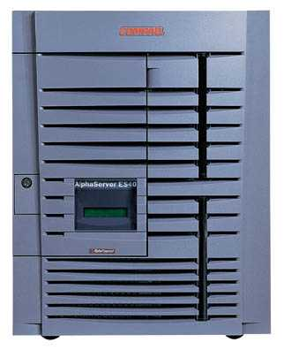


CSRF: Basic Picture
Server Victim
establish session
1
send forged request
4
2
3
visit server
User Victim
receive malicious page
Attack Server
Q: how long do you stay logged on to Gmail?

Slide 4
Reminder: HTTP Cookie
To make HTTP protocol stateful.
The server sends an extra header with an HTTP response.
E.g.,
Set-Cookie: attribute=value; domain=.arachna.com; path=/edu; expires=Thu, 24-Jun-2004 00:37:39 GMT; secure
The browser simply returns the name/value pair in the request headers (for authentication):
Cookie: attribute=value
As long as all constraints are fulfilled and the session is open.

Slide 5
Session Using Cookies
Browser
Server
POST/login.cgi
Set-cookie: authenticator
GET…
Cookie: authenticator
response

Slide 6
Cookie Authentication: Not Enough!
Users logs into bank.com, forgets to sign off
Session cookie remains in browser state
User then visits a malicious website containing
<form name=BillPayForm
action=http://bank.com/BillPay.php>
<input name=recipient value=badguy> …
<script> document.BillPayForm.submit(); </script>
Browser sends cookie, payment request fulfilled!
Lesson: cookie authentication is not sufficient when side effects can happen

Slide 7
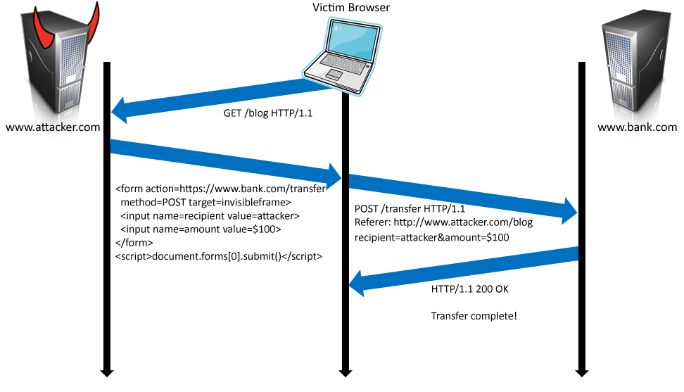
XSRF in More Detail

Slide 8
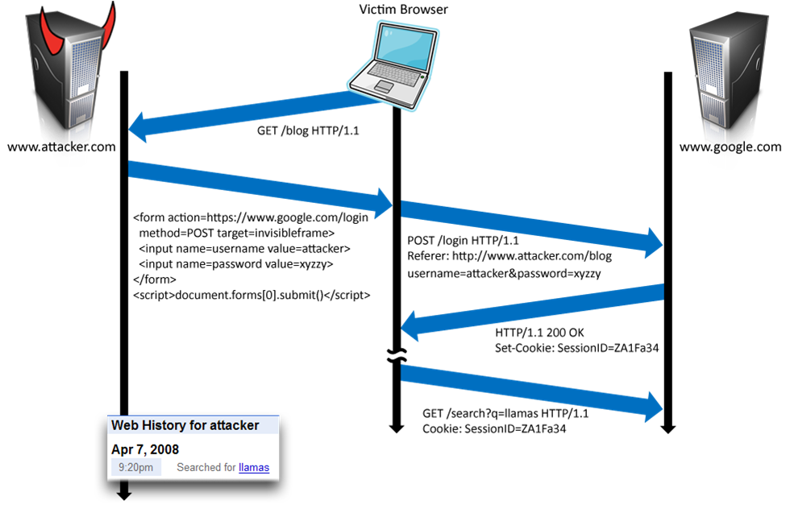
Login XSRF
Notes:
Use your own username password to login, but the activity is the victim’s web history
The attacker can see the users search. history. It is as if the attacker is logged in
Talk about David Airy’s incident and filtering the email to go to attacker!

Slide 9
CSRF Defenses
Secret token
Place nonce in page/form from honest site
Check nonce in POST
Confirm part of ongoing session with server
Token in POST can be HMAC of session ID in cookie
Nonce should be stored not as part of cookie.
Check referrer header
Referrer header is provided by browser, not script
Not very secure / susceptible to XSS.
Unfortunately, often filtered for privacy reasons

Slide 10
Defense
Requiring the client to provide authentication data in the same HTTP Request used to perform any operation with security implications
Double Submit Cookies:
Server requires the cookie value be send also by the form.
Limiting the lifetime of session cookies

